Slide 1
RPIW Process Flow Mapping

Slide 2
Set up the Flow Chart
Write event title and current state or future state across the top
Draw process clock and departments/operators on left vertical axis
Label departments/operators using Yellow Post-Its
Add horizontal lines to separate the departments

Slide 3
Add high level steps
Add high level process steps above the top line using Purple Post-Its.
Add timeline under the purple process steps
Time

Slide 4
Add operators/actions
Add operators/actions on correct department line and beneath corresponding process step using Yellow Post-Its

Slide 5
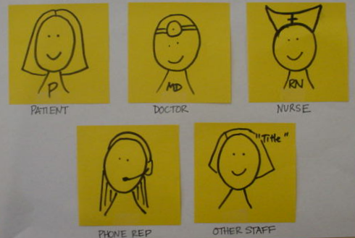
Here are some examples of operator/action notes:

Slide 6
Add Information Inputs
Add information inputs using Blue Post-Its in the upper left corner of the yellow notes. Add actual forms to the bottom of the chart if they are used in the step.

Slide 7
Examples of information inputs
Results entered into NextGen
Update patient demographic information
Lab results communicated to patient via letter
Symptoms documented in patient’s chart
Bill sent to patient via mail
Appointment reminder call via automated voicemail

Slide 8
Add Information Vehicles
Add the mode of information transmission using Green Post-Its.
Computer, phone, verbal, letter, etc.

Slide 9
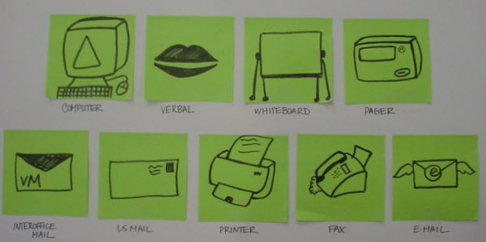
Typical information vehicle Post-its

Slide 10
Connect steps with yarn
Black yarn: current flow is seamless and defect free
Yellow yarn: flow is inappropriately timed, too fast or too slow
Red yarn: defects are flowing through the process, information is missing or stopped

Slide 11
Add Wastes
Add wastes using Pink Post-Its

Slide 12
Pink Notes Represent
Rework
Defects
Stopped information
Missing information
Waiting information
Lack of standard work
Patient safety concerns
Any other undesirable outcome/result

Slide 13
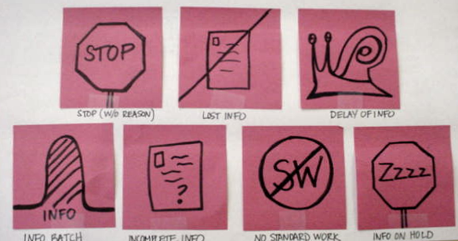
Examples of Wastes

Slide 14
Post-Its Reference Table
Purple Post-Its | High level process steps above the top line
Yellow Post-Its | Operators/actions on correct department line and beneath corresponding process step
Blue Post-Its | Information inputs in the upper left corner of the yellow notes
Green Post-Its | Mode of information transmission
Pink Post-Its | Waste & defects
Yarn Reference Table
Black Yarn | Current flow is seamless and defect free
Yellow Yarn | Flow is inappropriately timed, too fast or too slow
Red Yarn | Defects are flowing through the process, information is missing or stopped

Slide 15
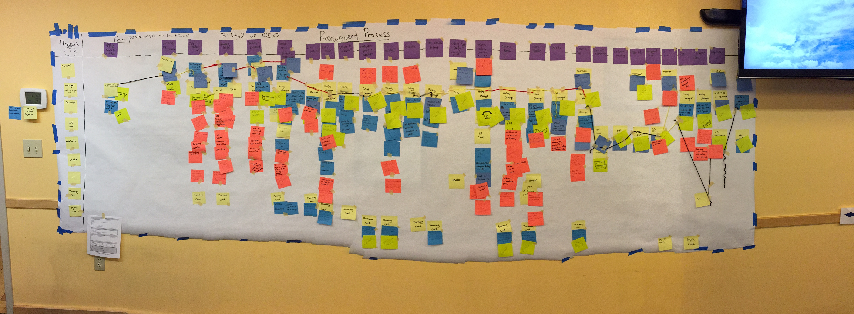
Complete Flow Map Example

Slide 16
EVERYONE Deserves GREAT CARE

